Slide 1
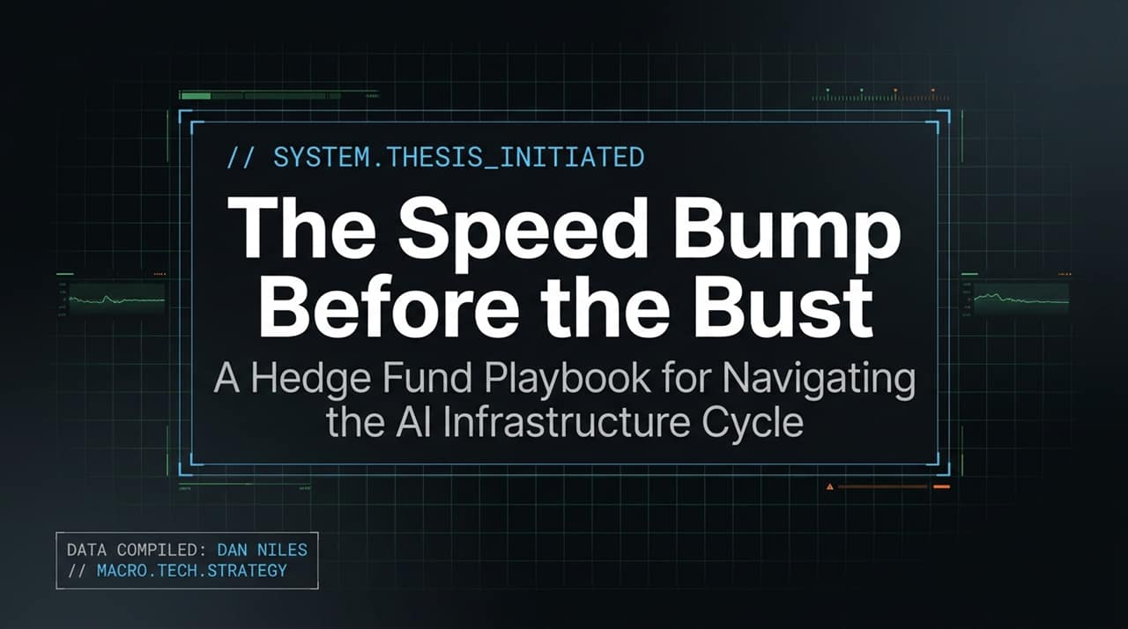
Notes:
https://www.youtube.com/watch?v=H26lu1CCi3o
Key Themes: AI infrastructure cycle, macro tech strategy, temporary speed bump vs. total bust.
Welcome, everyone. Today, we’re looking at navigating the AI infrastructure cycle, leveraging insights and data compiled by hedge fund manager Dan Niles.
AI is undeniably the most transformative technology of our generation—joining canals, railroads, and the internet in its ability to fundamentally alter human productivity.
However, every transformative technology eventually triggers overinvestment and ends in a bust as companies scramble out of fear of becoming obsolete.
The core thesis today: We are not at the final bust yet. Instead, we are navigating a high-velocity "speed bump". While the infrastructure buildout is real, the path forward will be violently volatile.

Slide 2
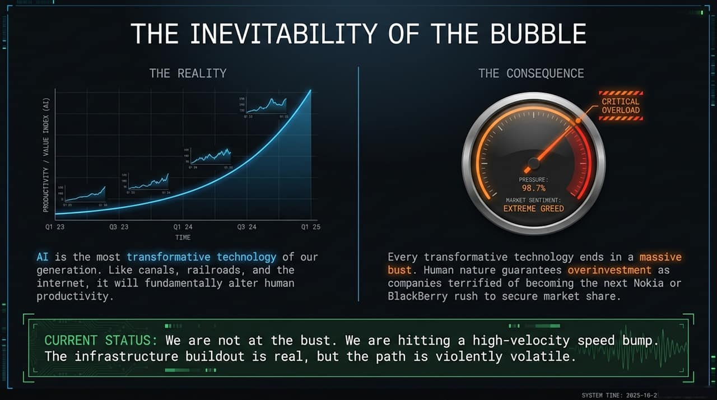
Notes:
If we look at the left side of the slide, "The Reality" highlights something that is virtually indisputable: Artificial Intelligence is the most transformative technology of our generation. Just like canals, railroads, and the early internet, AI will fundamentally alter global productivity. As veteran tech investor Dan Niles pointed out, every major technological leap creates a long-term economic shift. If we look back at the dot-com era—starting with the release of Netscape Navigator in late 1994—the semiconductor index skyrocketed by 850% through to the peak in March 2000. The core premise behind AI value creation is very real.
However, turning to the right panel—"The Consequence"—history teaches us that human psychology guarantees overinvestment during periods of paradigm shifts. Right now, market sentiment reflects extreme greed and high pressure. Why? Because corporate leaders are terrified of becoming the next Nokia or BlackBerry—dominant market leaders who failed to adapt and were wiped out almost overnight. When dozens of competing companies spend aggressively, each assuming they will capture significant market share, overinvestment is inevitable. Ultimately, every transformative tech cycle eventually ends in a market shakeout or bust.
That brings us to our "Current Status" at the bottom of the slide: We are not at the final bust yet—we are hitting a high-velocity speed bump. In the 1990s internet boom, before the actual bubble burst in 2000, the market suffered two brutal 50% drawdowns—one in 1995 and another in 1997. What we are seeing today in the AI space is a similar mid-cycle adjustment. Companies are transitioning from unconstrained AI experimentation to cost optimization—such as Uber blowing through its annual AI budget in four months, or Coinbase cutting spend by routing queries to cheaper models. Enterprise CFOs are now demanding a clear Return on Invested Capital before approving the next wave of capital expenditure.
To summarize: The underlying infrastructure buildout is real—driven by next-generation demands like Agentic AI, which requires 10 to 100 times more compute tokens. However, the path forward will be violently volatile. As investors and leaders, we must distinguish between short-term macro speed bumps and the end of the cycle, while managing downside risk in an environment driven by high valuation and rapid commoditization.
Key Talking Points:
Core Thesis: Artificial Intelligence represents the single most transformative technology of our generation. Similar to historical infrastructure buildouts like canals, railroads, and the internet, AI is set to permanently restructure human productivity.
Human Nature & Investment Behavior: Every single major technological revolution inevitably leads to a massive market bubble. Corporate FOMO (fear of missing out)—specifically the fear of becoming obsolete like Nokia or BlackBerry —forces aggressive overinvestment as companies race to secure market share.
Current Market Status: We have not reached the final, apocalyptic market bust. Instead, the market is currently navigating a high-velocity, highly volatile "speed bump". While the physical infrastructure buildout is genuine, the path forward will be marked by severe volatility.

Slide 3
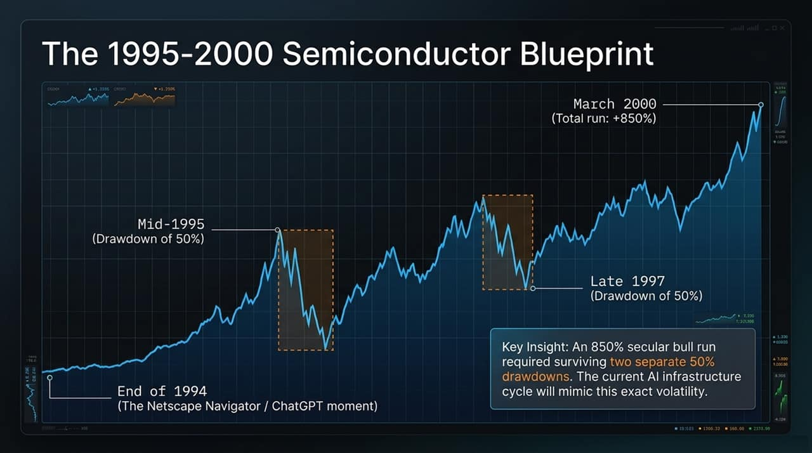
Notes:
To understand today’s AI environment, we look at the 1995–2000 semiconductor cycle.
Late 1994 was the "Netscape Navigator moment"—the equivalent of ChatGPT launching—which kicked off the public web browser era.
Over the next five years, the semiconductor index surged by +850% up to the March 2000 peak.
However, capturing that 850% secular bull run required surviving two separate ~50% drawdowns—one in mid-1995 and another in late 1997.
Dan Niles points out that current AI market volatility mimics these exact mid-cycle pullbacks. A massive long-term secular trend does not mean smooth sailing.
Key Talking Points:
Historical Analogy (The Netscape Moment): Draw a direct parallel between late 1994 (the launch of Netscape Navigator—the "ChatGP moment" of the internet age) and current AI adoption.
Anatomy of an 850% Bull Run: Between late 1994 and the market peak in March 2000, semiconductor stocks delivered an astounding 850% total return.
Surviving Severe Drawdowns: Reaching that 850% run required investors to endure two distinct 50% drawdowns:
Mid-1995 Drawdown: A ~50% drop that lasted nearly a year before resuming its upward trajectory.
Late-1997 Drawdown: A second ~50% decline before the final parabolic blow-off top in 2000.
Takeaway: Today’s AI market volatility is not the end of the secular bull market; it is mimicking the cyclical 50% drawdowns seen in mid-cycle semiconductor history.

Slide 4
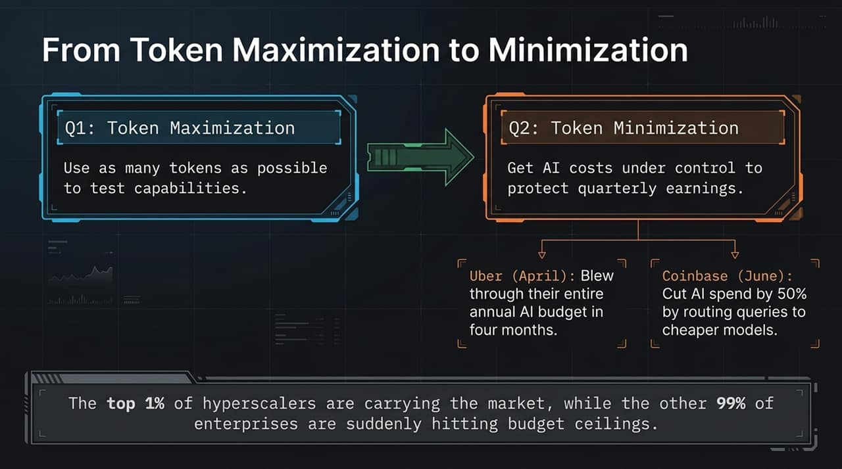
Notes:
In Q1, the mandate across corporate enterprise was "Token Maximization"—testing AI capabilities at all costs.
By Q2, CFOs hit a wall and shifted to "Token Minimization" to protect quarterly earnings.
Real-world examples highlight this budget friction:
Uber (April): Blew through its entire annual AI budget in just four months.
Coinbase (June): Slashed AI spend by 50% by routing queries away from expensive frontier models to cheaper options.
While the top 1% of hyperscalers continue to drive market spend, the remaining 99% of enterprises are running into hard budget ceilings.
Key Talking Points:
Shift in Enterprise Behavior:
Q1 (Maximization): Enterprises urged engineers to use as many LLM tokens as possible to test capabilities.
Q2 (Minimization): CFOs stepped in to protect quarterly earnings by imposing strict cost controls on AI budgets.
Case Studies:
Uber (April): Exhausted its entire annual AI budget within just four months.
Coinbase (June): Slashed AI costs by roughly 50% by intelligently routing queries to cheaper, lighter models.
The Structural Divide: A sharp divergence has emerged: the top 1% of hyperscalers continue massive infrastructure spend, whereas the remaining 99% of enterprise adopters are hitting strict capital budget ceilings.

Slide 5
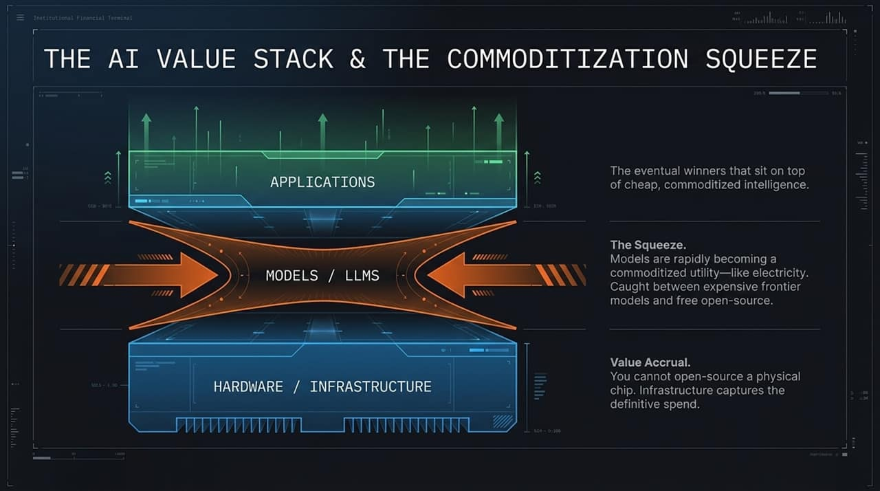
Notes:
Let's break down where value actually accrues in the AI stack:
Hardware / Infrastructure (Bottom): Captures definitive, physical spend. You cannot open-source a physical silicon chip, giving hardware the strong value accrual right now.
Models / LLMs (Middle): Squeezed severely. Models are rapidly becoming commoditized utility—like electricity. They are caught between hyper-expensive frontier models and virtually free open-source options.
Applications (Top): The ultimate long-term winners sit here, building consumer/enterprise sticky products on top of cheap, commoditized intelligence.
Key Talking Points:
Value Accrual at the Hardware Layer: Physical chips and compute infrastructure capture the definitive spend because hardware cannot be open-sourced.
The Model Layer Squeeze: Base LLM models are rapidly becoming a commoditized utility—much like electricity. Proprietary model builders are squeezed between expensive frontier development costs and free open-source solutions.
Application Layer Value Capture: Over time, the ultimate winners will be application platforms that leverage cheap, ubiquitous intelligence to deliver end-user productivity.

Slide 6
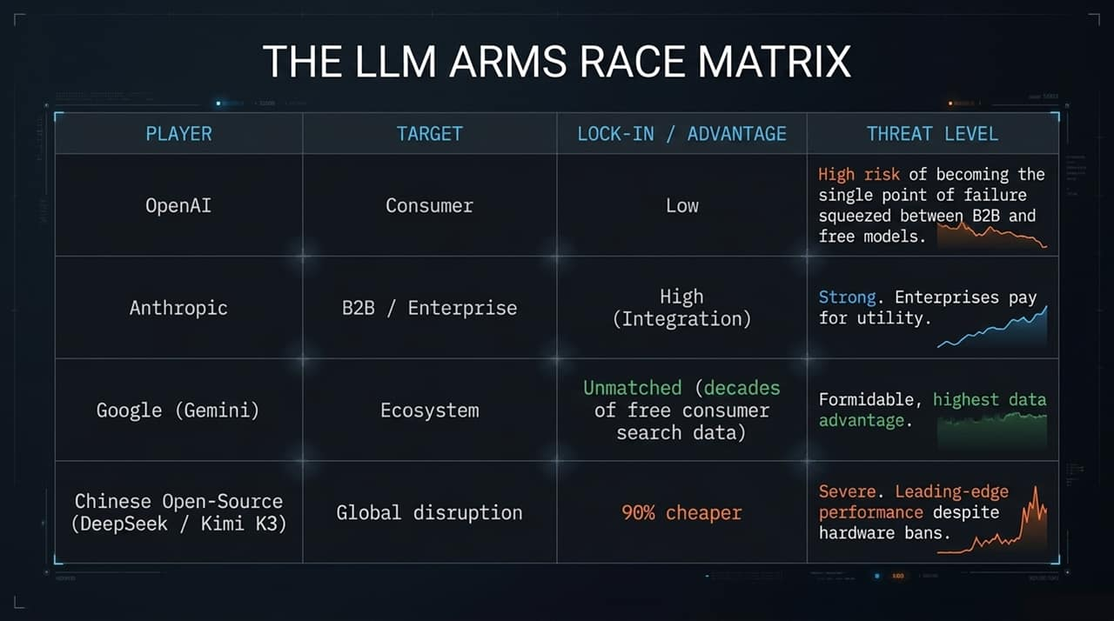
Notes:
Looking at key players across target focus, lock-in, and threat levels:
OpenAI: Consumer focus, but low lock-in. High risk of being a single point of failure as it gets squeezed between B2B leaders and free open-source models.
Anthropic: B2B / Enterprise focus with high integration lock-in. Strong position because enterprises willingly pay for functional utility.
Google (Gemini): Ecosystem play with unmatched data lock-in from decades of free consumer search data.
Chinese Open-Source (DeepSeek / Kimi K3): Global disruptor offering performance 90% cheaper. Posit a severe threat by delivering leading-edge performance despite US chip bans.
Key Talking Points:
OpenAI (High Single-Point-of-Failure Risk): Heavily focused on consumers who expect free access. Squeezed between enterprise-focused competitors and free open-source models.
Anthropic (Strong B2B Positioning): Positioned effectively in enterprise/B2B sectors where corporate clients pay for utility and workflows. High platform stickiness once integrated.
Google / Gemini (Formidable Ecosystem Advantage): Holds decades of consumer search and video training data. Deep integration into existing web ecosystems provides unparalleled scale.

Slide 7
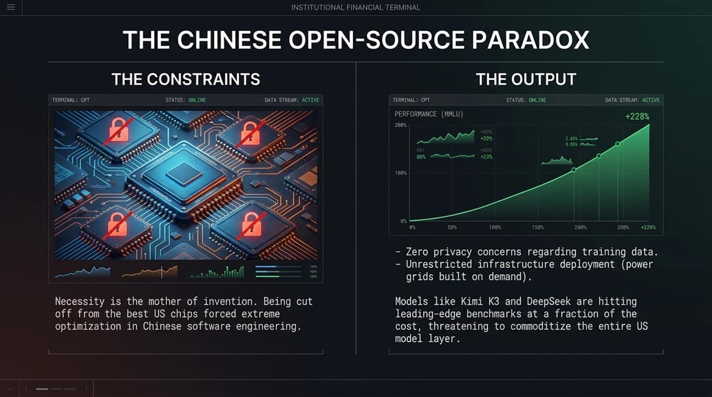
Notes:
"Necessity is the mother of invention." Being cut off from top-tier US silicon forced extreme optimization in Chinese software engineering.
Furthermore, Chinese developers face minimal training data privacy constraints and benefit from unrestricted infrastructure deployment (e.g., power grids built on demand).
Models like Kimi K3 and DeepSeek match leading-edge MMLU benchmarks at a fraction of the cost, threatening to commoditize the entire US model layer.
Key Talking Points:
Innovation Under Constraints: US hardware sanctions restricted Chinese access to top-tier GPUs. This forced Chinese software engineers to radically optimize code and architecture.
Structural Advantages: Chinese developers operate with negligible privacy constraints regarding training data and can deploy unrestricted power infrastructure on demand.
The Threat to Western Models: Open-source models like DeepSeek and Kimi K3 hit leading-edge benchmarks at a fraction of Western costs, threatening to commoditize base LLM software globally.

Slide 8
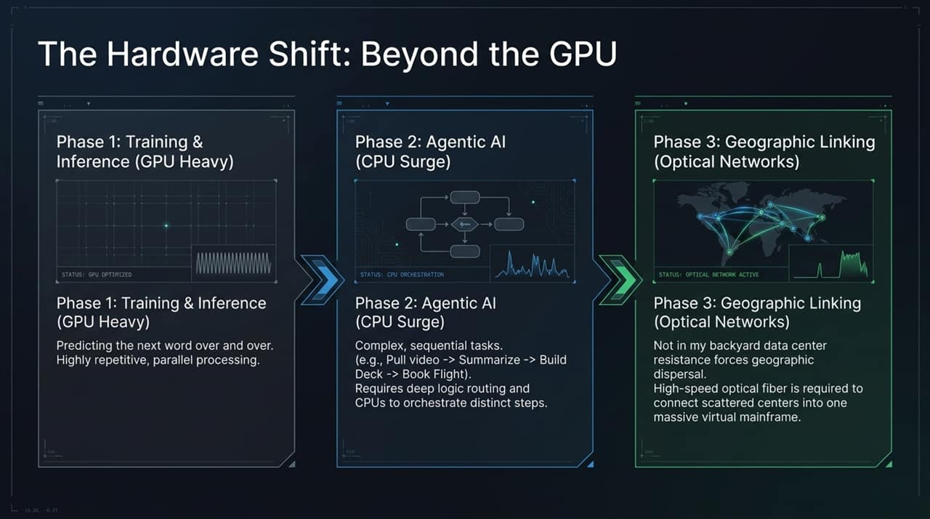
Notes:
Hardware demand is evolving through three distinct phases:
Phase 1 — Training & Inference (GPU Heavy): Predicting the next word in parallel loops. Highly repetitive and GPU-optimized.
Phase 2 — Agentic AI (CPU Surge): Multi-step sequential logic (e.g., "Pull video $\rightarrow$ Summarize $\rightarrow$ Build Deck $\rightarrow$ Book Flight"). Requires deep logic routing and orchestration, driving a surge in high-performance CPU demand.
Phase 3 — Geographic Linking (Optical Networks): Power constraints and "not-in-my-backyard" data center resistance force data centers to disperse geographically. High-speed optical fiber connects scattered centers into one massive virtual mainframe.
Key Talking Points:
Phase 1 (Training & Inference - GPU Dominant): Highly repetitive parallel compute focused on word prediction.
Phase 2 (Agentic AI - CPU Surge): Transition to multi-step, complex execution (e.g., pulling videos, summarizing, generating slides, booking travel. These sequential tasks require deep logic orchestration, driving a surge in high-performance CPU demand.
Phase 3 (Geographic Interconnects - Optical Networks): Local resistance to massive data centers forces facilities to be geographically dispersed. Connecting these dispersed nodes into single virtual supercomputers will require a major shift from copper to high-speed optical fiber links.

Slide 9
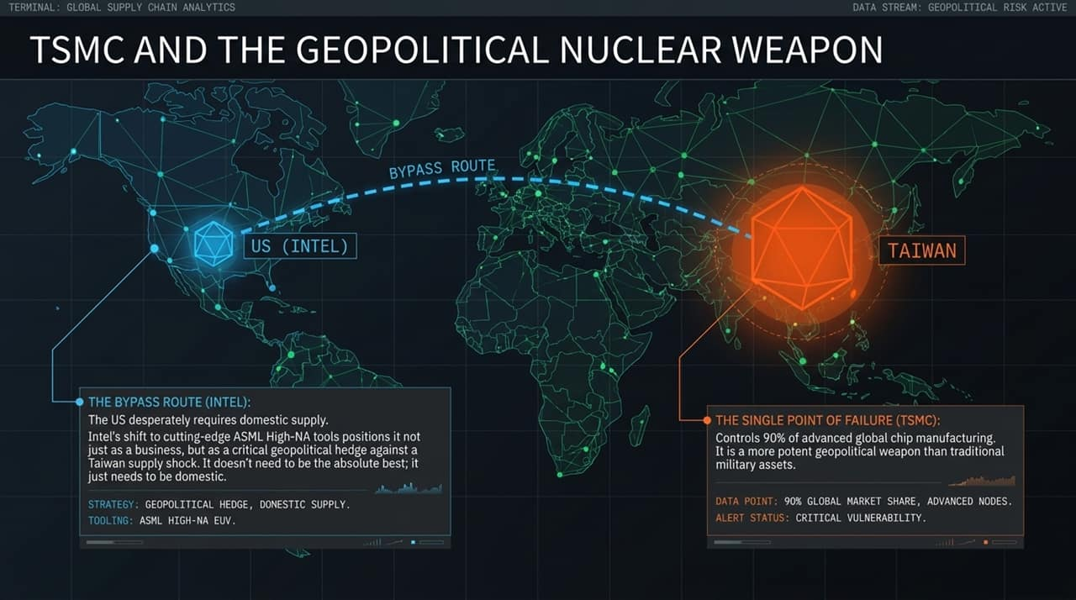
Notes:
TSMC controls ~90% of advanced global chip manufacturing, making it a more potent geopolitical single point of failure than traditional military assets.
The US desperately needs domestic, onshore manufacturing.
Intel’s aggressive shift toward cutting-edge ASML High-NA EUV tools positions it not just as a business turnaround, but as a essential domestic geopolitical hedge against a Taiwan supply shock.
Key Talking Points:
TSMC as a Single Point of Failure: TSMC produces over 90% of advanced semiconductor logic globally. This concentration makes it a critical geopolitical risk.
The Intel Bypass Route: The United States urgentl requires domestic fabrication capability.
ASML High-NA Tools: Intel’s early adoption of ASML’s $400M High-NA EUV tools positions it as a key domestic hedge against potential Asian supply disruptions. Intel does not need to outperform TSMC across all metrics; it simply needs to provide a secure domestic alternative.

Slide 10
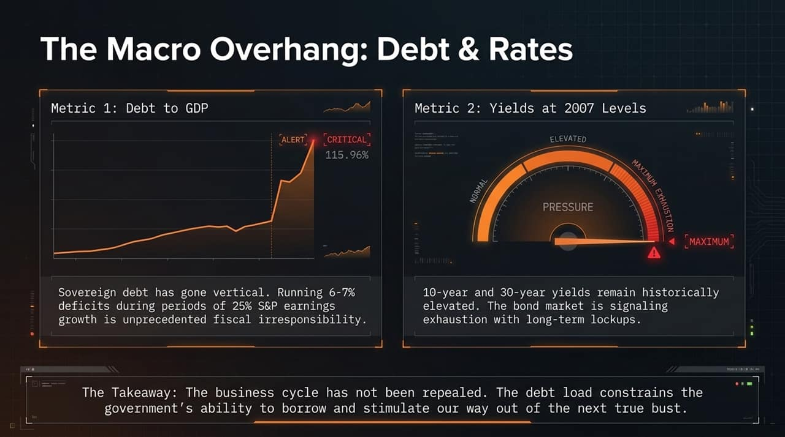
Notes:
The broader macro environment presents severe risk constraints:
Debt-to-GDP: Reaching 115%+ in sovereign debt. Running 6–7% fiscal deficits during periods of 25% S&P earnings growth is unprecedented fiscal risk.
Yields at 2007 Levels: 10-year and 30-year yields remain historically elevated. The bond market is signaling exhaustion with long-term lockups.
Takeaway: The business cycle has not been repealed. High debt loads constrain governments from simply borrowing their way out of the next true bust.
Key Talking Points:
Sovereign Debt at Critical Levels: Debt-to-GDP ratios across major developed nations have surged dramatically. Running 6–7% government deficits during periods of strong corporate earnings growth reflects significant fiscal expansion.
Elevated Yield Environment: Long-term treasury yields remain near multi-year highs, signaling that bond markets are resisting long-term lockups at low yields.
Macro Implications: High sovereign debt levels severely constrain government capacity to borrow and stimulate the economy when the next major economic downturn arrives.

Slide 11
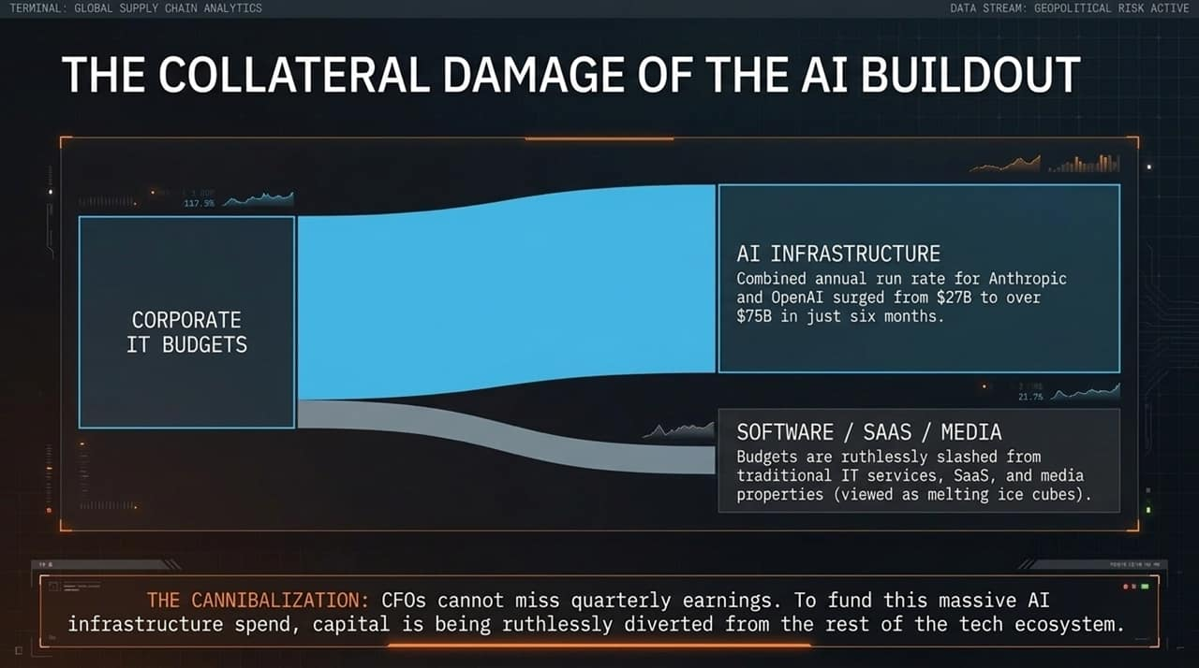
Notes:
Where is the money for AI coming from? Enterprise CFOs cannot miss earnings, so capital is being aggressively cannibalized.
Combined annual run rate for Anthropic and OpenAI jumped from $27B to over $75B in just six months.
To fund this spend, corporate IT budgets are being ruthlessly slashed away from traditional IT services, SaaS, and media properties (viewed as "melting ice cubes").
Key Talking Points:
Surging AI Budgets: Capital allocation toward primary AI model developers surged dramatically within short timeframes.
Cannibalization of Corporate IT Budgets: To keep quarterly earnings intact while funding AI buildouts, CFOs are reallocating funds away from traditional enterprise software, IT consulting, and legacy SaaS products.
Legacy Impact: Non-AI enterprise software and media sectors are increasingly treated as legacy lines during budget allocation cycles.

Slide 12
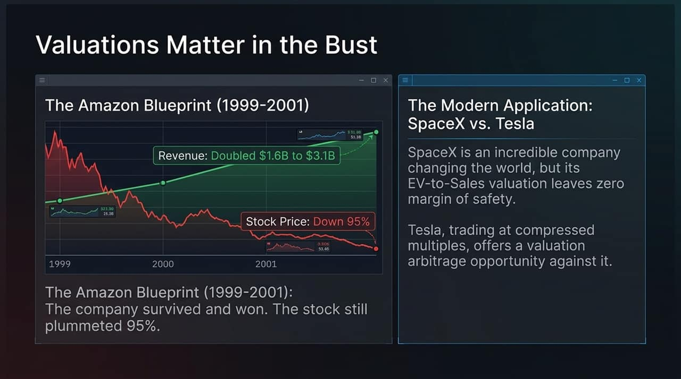
Notes:
Fundamentals catch up in the end:
The Amazon Blueprint (1999–2001): Between 1999 and 2001, Amazon’s revenue almost doubled from $1.6B to $3.1B. Yet, its stock price plummeted 95% because valuation multiples collapsed.
Modern Application (SpaceX vs. Tesla): While SpaceX is a category-defining company, extreme EV-to-Sales multiples leave zero margin of safety. Tesla, trading at more compressed multiples, presents a relative valuation arbitrage opportunity.
Key Talking Points:
The Amazon Blueprint (1999–2001):
Between 1999 and 2001, Amazon’s net revenues nearly doubled from $1.6B to $3.1B.
Despite strong revenue growth, its stock price declined 95% from peak to trough as market multiples compressed.
Modern Valuation Comparisons: High EV-to-Sales multiples leave minimal margin of safety for growth companies during market re-ratings. Comparing compressed multiples against premium-valued leaders offers potential valuation arbitrage opportunities.
Key Takeaway: Strong fundamental growth does not protect high-multiple stocks from sharp contractions during a broader market repricing.

Slide 13
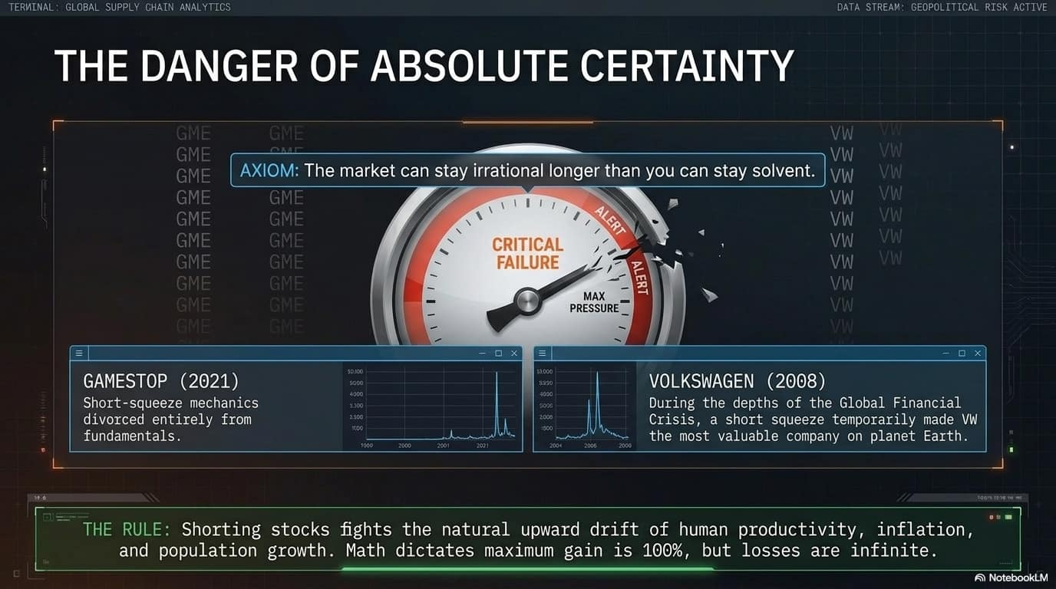
Notes:
Axiom: "The market can stay irrational longer than you can stay solvent."
Volkswagen (2008): In the depths of the Global Financial Crisis, a short squeeze briefly made VW the most valuable company on Earth.
GameStop (2021): Squeeze mechanics divorced entirely from fundamental underlying business value.
The Shorting Rule: Shorting stocks fights the natural upward drive of human productivity, population growth, and inflation. Math dictates a maximum gain of 100%, but potential losses are infinite.
Key Talking Points:
Market Squeeze Mechanics: Unconstrained short positions carry asymmetric downside risk, as prices can disconnect entirely from underlying fundamentals during market squeezes.
Historical Precedents:
Volkswagen (2008): A short squeeze briefly made VW the most valuable company in the world during the Global Financial Crisis.
GameStop (2021): Rapid retail buying mechanics squeezed heavily shorted positions regardless of financial metrics.
Structural Drift: Shorting equities fights long-term economic expansion, productivity growth, and inflation. Max upside is 100%, whereas max loss is theoretically unlimited.

Slide 14
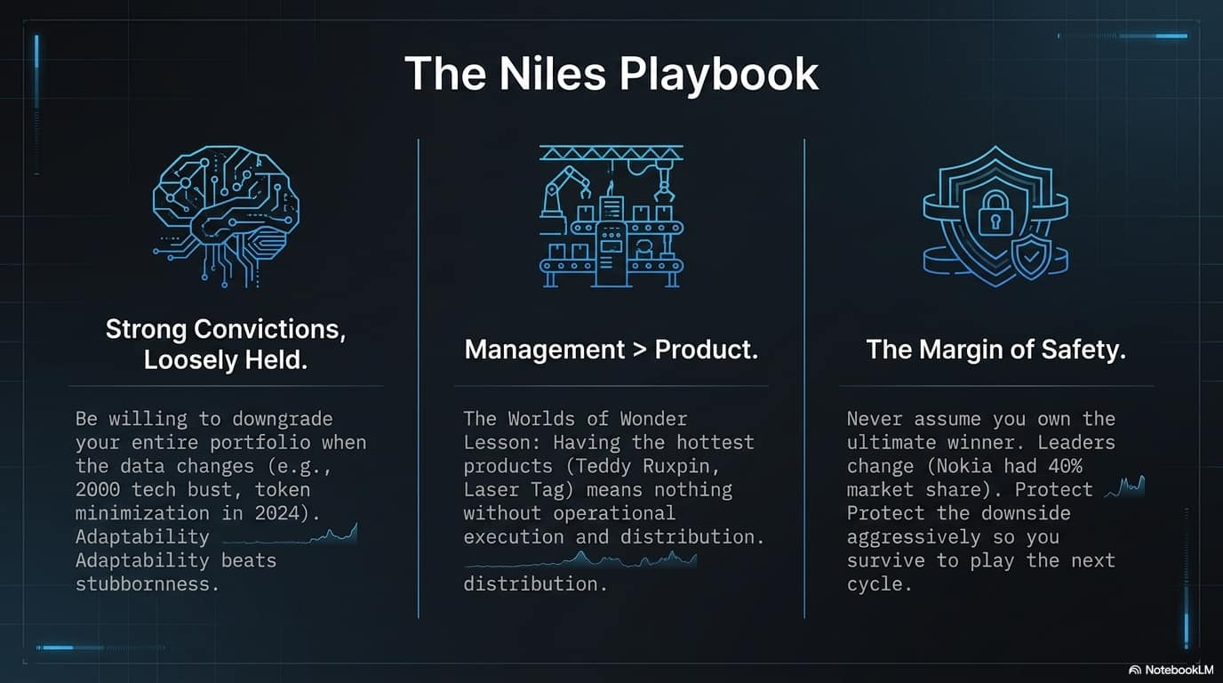
Notes:
Strong Convictions, Loosely Held: Be fully prepared to downgrade your entire portfolio when the data changes (as in the 2000 tech bust or the 2024 token minimization shift). Adaptability beats stubbornness every time.
Management > Product (The Worlds of Wonder Lesson): In 1987, Worlds of Wonder had two of the top 10 selling toys (Teddy Ruxpin, Laser Tag) and still filed for bankruptcy by Christmas because management failed at production and distribution execution.
Margin of Safety: Never assume you hold the perpetual winner. Market leaders change (Nokia once held 40% phone market share). Aggressively protect downside to survive.
Key Talking Points:
Strong Convictions, Loosely Held: Adapt quickly and change portfolio allocation as fresh market data emerges.
Management > Product (The Worlds of Wonder Lesson): Having top-selling consumer products (e.g., Teddy Ruxpin, Lazer Tag) is meaningless without disciplined operational execution, production, and distribution management.
Margin of Safety: Never assume today's market leader will remain dominant indefinitely (e.g., Nokia previously held 40% mobile market share). Aggressively hedge downside risk to navigate full market cycles.

Slide 15
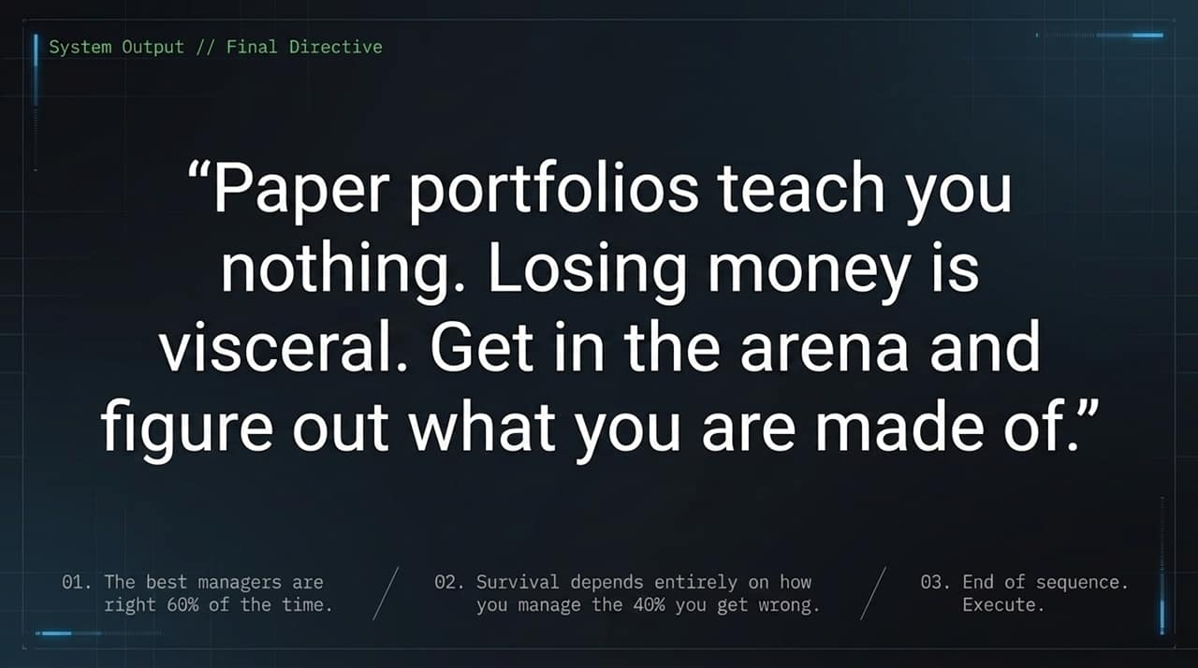
Notes:
"Paper portfolios teach you nothing. Losing money is visceral. Get in the arena and figure out what you are made of."
The best fund managers are only right roughly 60% of the time.
Long-term survival depends entirely on how effectively you manage and mitigate the 40% of calls you get wrong.
Key Talking Points:
Active Portfolio Discipline: Theoretical portfolios fail to build real risk management discipline; actual market participation provides necessary execution feedback.
Managing the 40%: The best portfolio managers are right around 60% of the time. Long-term performance depends on cutting losses quickly on the 40% of positions that fail.
Execution: Adapt to incoming data, protect downside capital, and execute decisively.

Slide 16
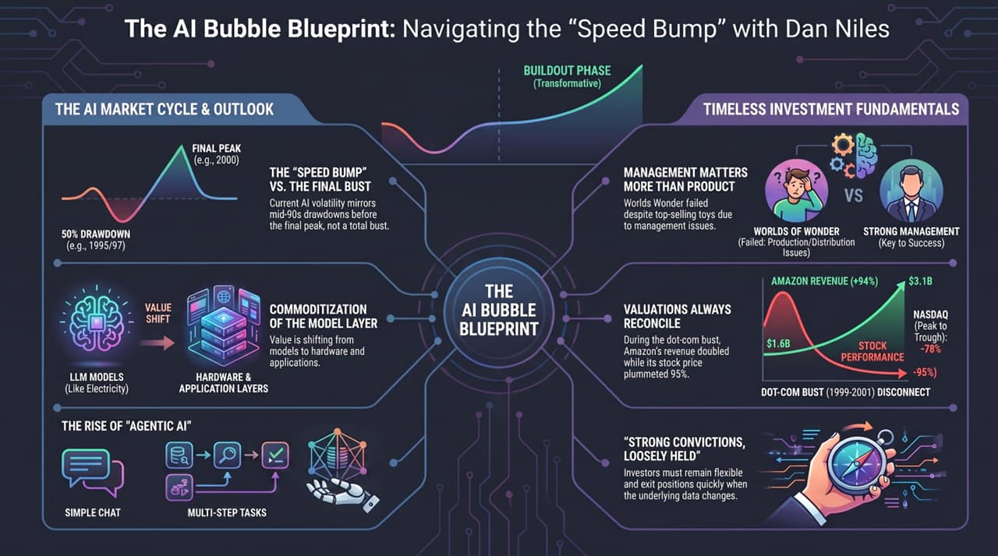
Notes:
To conclude, this framework outlines our roadmap:
Cycle Position: We are in the buildout phase, facing mid-cycle 50% drawdowns (speed bumps), not the final 80% market bust.
Value Shift: Intelligence/Models commoditize into utilities; value shifts to Hardware and Applications.
Tech Driver: Agentic AI is transitioning demand from GPU parallel loops to multi-step CPU logic.
Execution Discipline: Management execution outweighs product hype, and strict risk discipline ensures survival into the next cycle.
Key Talking Points:
Cycle Navigation: Distinguish between cyclical 50% drawdowns ("speed bumps") and structural cycle tops.
Value Realignment: Anticipate capital shifting away from commoditized base models into physical hardware infrastructure and productivity-focused application layers.
Disciplined Execution: Focus on management quality, maintain strict valuation discipline, and hold strong convictions loosely as data evolves,

